Slide 1
Clean Code Functions

Slide 2
Split Code into Functions
F.1: “Package” meaningful operations as carefully named functions
More readable
More likely to be reused
Less likely to contain errors

Slide 3
First Rule About Functions (Clean Code)
Functions should be small.
Even smaller than that!
No more than 4 lines!
F.3: Keep functions short and simple
Functions should fit on a screen
Break large functions up into smaller cohesive and named functions
One-to-five-lines functions should be considered normal

Slide 4
Do One Thing
Functions should do one thing
They should do it well
They should do it only
F.2: A function should perform a single logical operation

Slide 5
Do One Thing
int compute_save_and_print_results(int a, int b, std::vector<int>& results) { auto new_result = a + b; // complex computation... results.push_back(new_result); std::for_each(cbegin(results), cend(results), [](int r){ std::cout << r << "\n";}); return new_result; }

Slide 6
Do One Thing
int compute_result(int a, int b) { return a + b; }
void save_result(int new_result, std::vector<int>& results) { results.push_back(new_result); }
void print_results(const std::vector<int>& results) { std::for_each(cbegin(results), cend(results), [](int r){ std::cout << r << "\n"; }); }

Slide 7
Do One Thing
// Better, but still sketchy. (See later for further refinement.)
void process_new_sensor_data(int a, int b, std::vector<int>& results) { auto new_result = compute_result(a, b); save_result(new_result, results); print_results(results); }

Slide 8
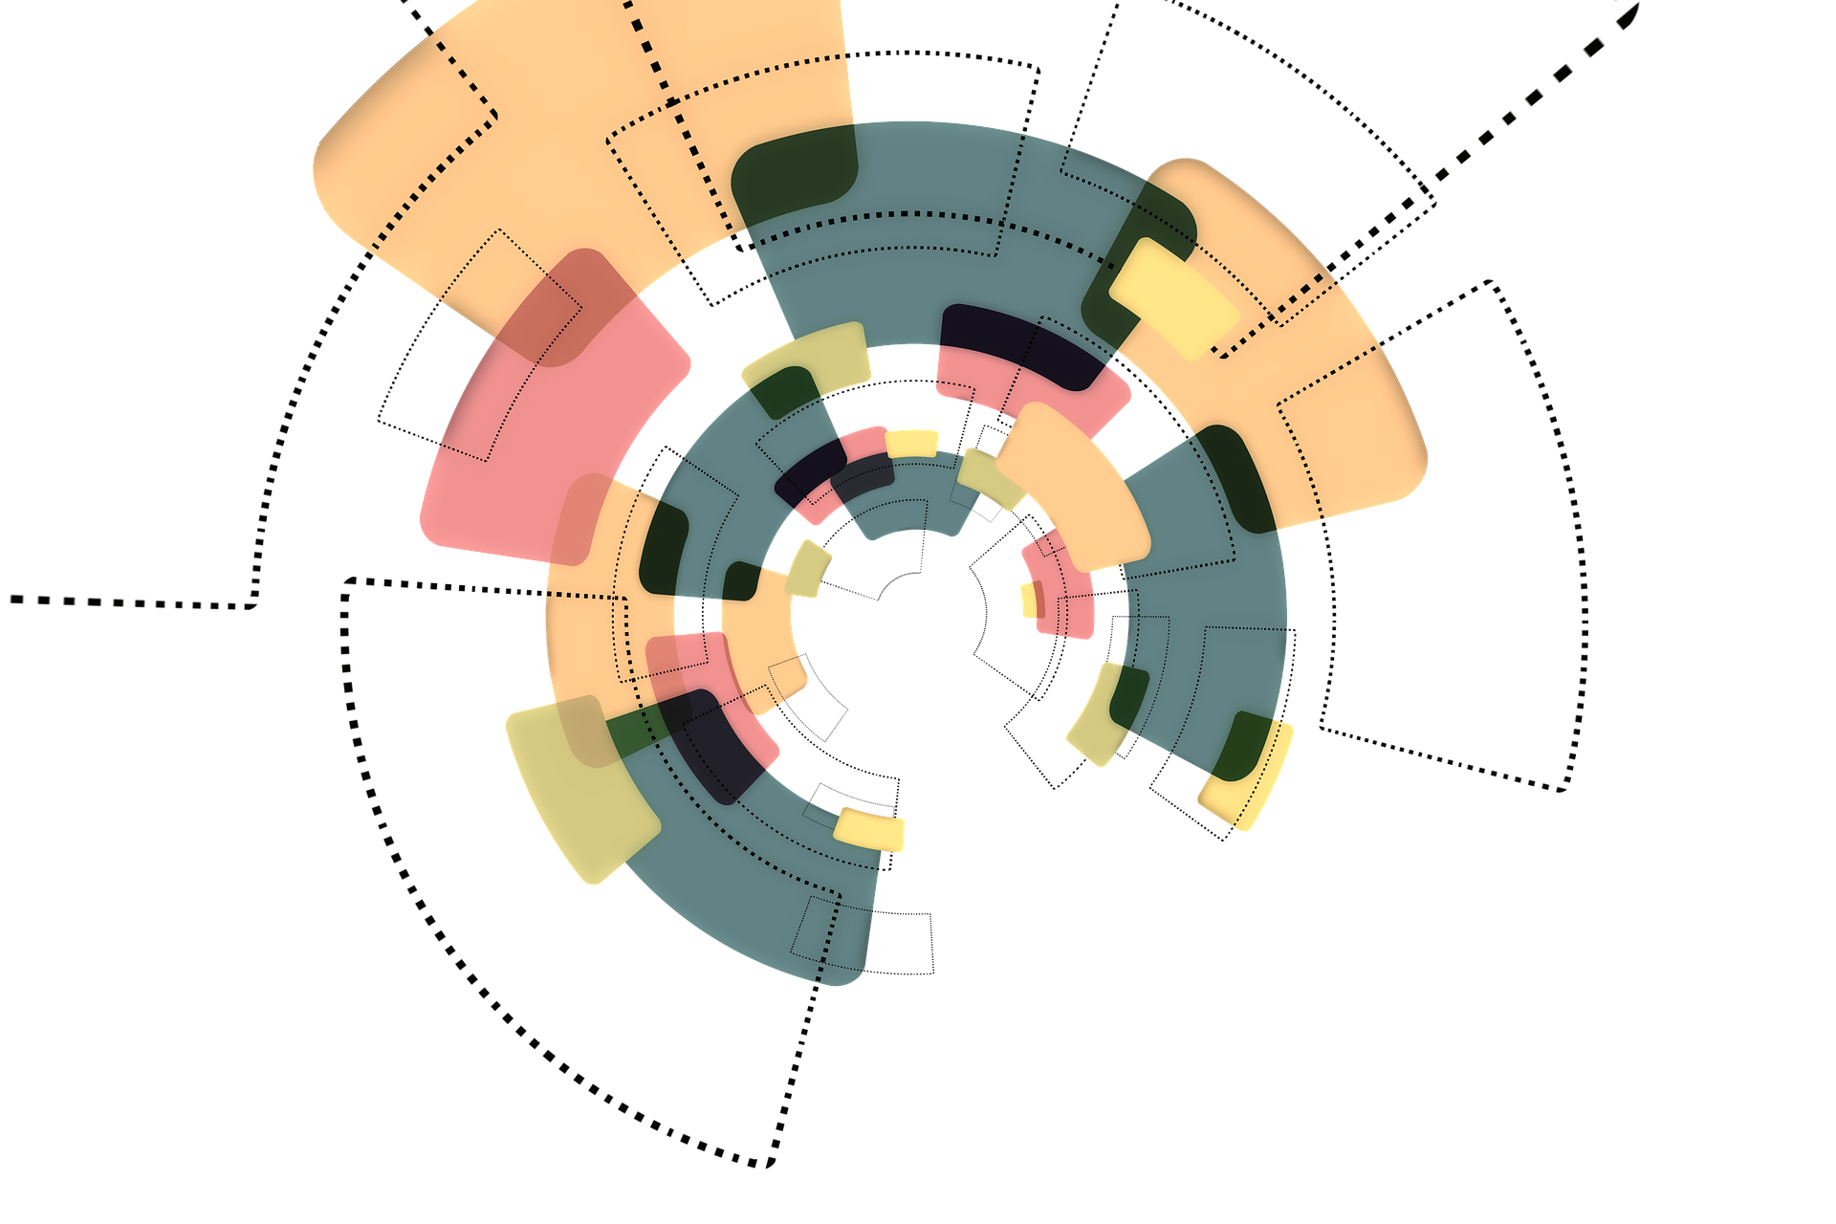
Abstraction Levels
Everything the function does in its body should be one (and only one) level of abstraction below the function itself.

Slide 9
“TO” paragraphs: Checking Levels of Abstraction
To render_page_with_setups_and_teardowns
We check to see whether the page is a test page and
if so, we include the setups and teardowns.
In either case we render the page in HTML

Slide 10

The Stepdown Rule
We want code to read like a top-down narrative
Every function should be followed by those one level of abstraction below it

Slide 11
Workshop: Do One Thing Only
The function handle_money_stuff(), defined in
Workshops/SalariesOriginal/salaries_original.cpp
does more than one thing.
Split it into several functions so that each does one thing only. Ensure that
each function does its job well and is at a single level of abstraction,
all names are appropriate, and
the code is easy to understand.
Note: You can use Workshops/SalariesWorkshop/salaries_workshop.cpp for your solution
Hint: Start by renaming the variables according to the comments to simplify the rest of the work

Slide 12
Switches and Abstractions
Switch statements often perform operations on the same level of abstraction (for “subtypes” instead of the original type).
“Subtypes” are often distinguished by type tags.

Slide 13
enum class EmployeeType { commissioned, hourly, salaried, };
struct Money { long amount_in_cents{}; // ... };
struct Employee { EmployeeType type{}; // ... }

Slide 14
Money calculate_commissioned_pay(Employee e) { std::cout << "Calculating pay for commissioned employee."; return Money{}; }
Money calculate_hourly_pay(Employee e) { std::cout << "Calculating pay for hourly employee."; return Money{}; }
Money calculate_salaried_pay(Employee e) { std::cout << "Calculating pay for salaried employee."; return Money{}; }

Slide 15
Money calculate_pay(Employee e) { switch (e.type) { case EmployeeType::commissioned: return calculate_commissioned_pay(e); case EmployeeType::hourly: return calculate_hourly_pay(e); case EmployeeType::salaried: return calculate_salaried_pay(e); } }

Slide 16
Replace switch with Polymorphism
It is often better to replace switches with “real” subtyping and polymorphism:

Slide 17
struct AbstractEmployee { virtual Money calculate_pay() const = 0; };
struct CommissionedEmployee : public AbstractEmployee { virtual Money calculate_pay() const override { return Money{}; } };
struct HourlyEmployee : public AbstractEmployee { /* … */ };
struct SalariedEmployee : public AbstractEmployee { /* … */ };

Slide 18
std::unique_ptr<AbstractEmployee> create_employee(EmployeeType type) { switch (type) { case EmployeeType::commissioned: return std::make_unique<CommissionedEmployee>(); case EmployeeType::hourly: return std::make_unique<HourlyEmployee>(); case EmployeeType::salaried: return std::make_unique<SalariedEmployee>(); } }

Slide 19
struct EmployeeFactory { std::unique_ptr<Employee> make_employee(EmployeeRecord r) { switch (r.type) { case EmployeeType::commissioned: return std::make_unique<CommissionedEmployee>(r); case EmployeeType::hourly: return std::make_unique<HourlyEmployee>(r); case EmployeeType::salaried: return std::make_unique<SalariedEmploye>(r); default: throw InvalidEmployeeType(r.type); } } }

Slide 20
Money CommissionedEmployee::calculate_pay() { return calculate_commissioned_pay(*this); }
Money HourlyEmployee::calculate_pay() { return calculate_hourly_pay(*this); }
Money SalariedEmploye::calculate_pay() { return calculate_salaried_pay(*this); }

Slide 21
More Rules For Functions
Use descriptive names
Use few (or no) arguments
Don’t use Boolean arguments (flag arguments)
Avoid hidden side effects

Slide 22
Hidden Side Effects
bool checkPassword(std::string userName, std::string password) { User& user = UserGateway.findByName(userName); if (user != User.NULL) { std::string codedPhrase = user.getPhraseEncodedByPassword(); std::string phrase = cryptographer.decrypt(codedPhrase, password); if (phrase == "Valid Password") { session.initialize(); return true; } } return false; }

Slide 23
Avoid Output Arguments
HitResult hit_result;
player.check_collision(obstacle, hit_result);
if (hit_result.collision_occurred) {
…
}

Slide 24
Avoid Output Arguments
void check_collision(const Actor& a, HitResult& hit_result);

Slide 25
Avoid Output Arguments
std::unique_ptr<HitResult> check_collision(const Actor& a);

Slide 26
Avoid Output Arguments
auto hit_result{player.check_collision(obstacle)};
if (hit_result.collision_occurred) {
…
}

Slide 27
Command Query Separation
bool has_default_value() { if (default_value >= 0) return true; else { default_value = 123; return false; }

Slide 28
Command Query Separation
bool has_default_value() { return default_value >= 0; }
void set_default_value() { default_value = 123; }

Slide 29
Use Exceptions for Error Reporting
ErrorCode print_result() { if (!outstream) { return ErrorCode::STREAM_UNAVAILABLE; } // … return ErrorCode::NO_ERROR; }

Slide 30
void print_result() { if (!outstream) { throw std::runtime_error("No stream available"); } // … }

Slide 31
DRY: Don’t Repeat Yourself
Try to eliminate duplicated code
It bloats the code
It requires multiple modifications for every change
But: often duplicated code is interspersed with other code
Take into account the scope in which you keep code DRY!

Slide 32
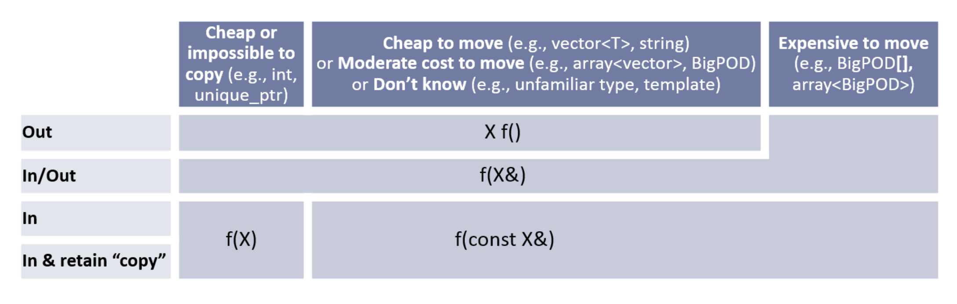
C++ Core Guidelines for Functions
F.15: Prefer simple and conventional ways of passing information

Slide 33
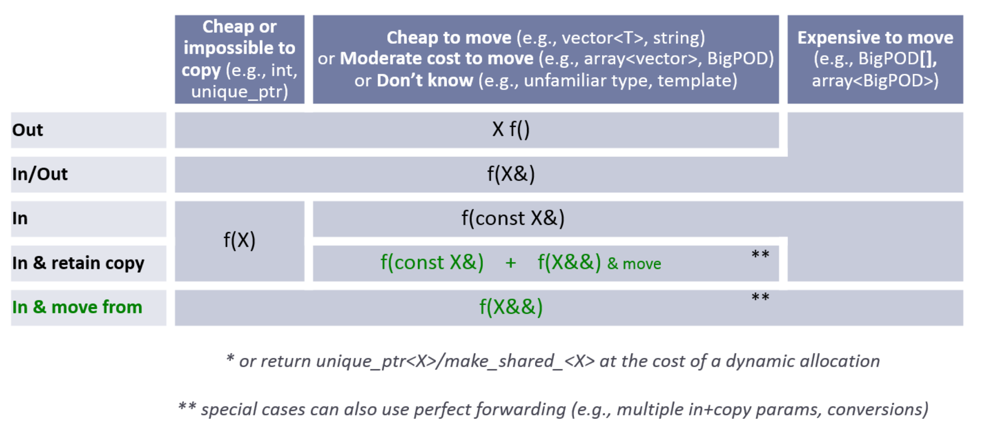
F.15: Prefer simple and conventional ways of passing information

Slide 34
C++ Core Guidelines for Functions
F.16: For “in” parameters, pass cheaply-copied types by value and others by reference to const
F.17: For “in-out” parameters, pass by reference to non-const
F.20: For “out” output values, prefer return values to output parameters
F.21: To return multiple “out” values, prefer returning a struct or tuple
F.60: Prefer T* over T& when “no argument” is a valid option

Slide 35
Workshop: Argument Passing
File Workshops/OneShots/argument_passing.cpp contains functions that do not conform to the C++ Core Guidelines about argument passing.
Update the functions so that they do.

Slide 36
C++ Core Guidelines for Functions
F.8: Prefer pure functions
F.7: For general use, take T* or T& arguments rather than smart pointers
R.3: A raw pointer (a T*) is non-owning
R.4: A raw reference (a T&) is non-owning
F.26: Use a unique_ptr<T> to transfer ownership where a pointer is needed
F.27: Use a shared_ptr<T> to share ownership

Slide 37
Workshop: Argument Passing / Ownership
File Workshops/OneShots/ownership_1.cpp contains functions that do not conform to the C++ Core Guidelines.
Update the functions so that they do.

Slide 38
Parameters and Return Values
F.22: Use T* or owner<T*> to designate a single object
F.42: Return a T* to indicate a position (only)
F.43: Never (directly or indirectly) return a pointer or a reference to a local object
F.44: Return a T& when copy is undesirable and “returning no object” isn’t needed
F.47: Return T& from assignment operators
F.48: Don’t return std::move(local)

